Slide 1

SOFTWARE ENGINEERING(M23DE0104)
Academic Year:2024-2025, ODD Semester
MCA I Semester, School of CSA
Dr. N. Kavitha
Professor

Slide 2
Unit-i
Introduction to Software Engineering and Software Process Models:
Professional Software Development, Software Development Myths, Attributes of good software, Software Engineering Diversity, IEEE/ACM code of Software Engineering Ethics, Case Studies. Software Process, and Software Process Models, Process, Activities, coping with the changes.

Slide 3
Learning objectives
To understand about what software engineering is and why it is important.
To understand that the development of different types of software systems may require different software engineering techniques.
To understand the concepts of software processes and software process models.
To understand why processes should be organized to cope with changes in the software requirements and design.

Slide 4
LECTURE-1 : Professional software development

Slide 5
Frequently asked questions about software engineering
Question | Answer
What is software? | Computer programs and associated documentation. Software products may be developed for a particular customer or may be developed for a general market.
What are the attributes of good software? | Good software should deliver the required functionality and performance to the user and should be maintainable, dependable and usable.
What is software engineering? | Software engineering is an engineering discipline that is concerned with all aspects of software production.
What are the fundamental software engineering activities? | Software specification, software development, software validation and software evolution.
What is the difference between software engineering and computer science? | Computer science focuses on theory and fundamentals; software engineering is concerned with the practicalities of developing and delivering useful software.
What is the difference between software engineering and system engineering? | System engineering is concerned with all aspects of computer-based systems development including hardware, software and process engineering. Software engineering is part of this more general process.

Slide 6
Question | Answer
What are the key challenges facing software engineering? | Coping with increasing diversity, demands for reduced delivery times and developing trustworthy software.
What are the costs of software engineering? | Roughly 60% of software costs are development costs, 40% are testing costs. For custom software, evolution costs often exceed development costs.
What are the best software engineering techniques and methods? | While all software projects have to be professionally managed and developed, different techniques are appropriate for different types of system. For example, games should always be developed using a series of prototypes whereas safety critical control systems require a complete and analyzable specification to be developed. You can’t, therefore, say that one method is better than another.
What differences has the web made to software engineering? | The web has led to the availability of software services and the possibility of developing highly distributed service-based systems. Web-based systems development has led to important advances in programming languages and software reuse.

Slide 7
Scope and Purpose of Software Development
Personal programs (e.g., hobbyist projects) are informal and for individual use.
Professional software, intended for use by someone apart from its developer, is usually developed by teams rather than individuals. It is maintained and changed throughout its life.
Software engineering is intended to support professional software development, rather than individual programming. It includes techniques that support program specification, design, and evolution, none of which are normally relevant for personal software development.
Many people think that software is simply another word for computer programs. However, when we are talking about software engineering
software is not just the programs themselves but also all associated documentation and configuration data that is required to make these programs operate correctly.

Slide 8
A professionally developed software system is often more than a single program.
The system usually consists of a number of separate programs and configuration files that are used to set up these programs. It may include system documentation, which describes the structure of the system; user documentation, which explains how to use the system, and websites for users to download recent product information.
This is one of the important differences between professional and amateur software development. If you are writing a program for yourself, no one else will use it and you don’t have to worry about writing program guides, documenting the program design, etc.
However, if you are writing software that other people will use and other engineers will change then you usually have to provide additional information as well as the code of the program.

Slide 9
Software Products
Software engineers are concerned with developing software products (i.e., software which can be sold to a customer).
There are two kinds of software products:
Generic products
These are stand-alone systems that are produced by a development organization and sold on the open market to any customer who is able to buy them.
Examples of this type of product include software for PCs such as databases, word processors, drawing packages, and project-management tools.
It also includes so-called vertical applications designed for some specific purpose such as library information systems, accounting systems, or systems for maintaining dental records.

Slide 10
  Customized products
  Software that is commissioned by a specific customer to meet their own needs.
  Examples – embedded control systems, air traffic control software, traffic monitoring systems.
Product specification
Generic products
  The specification of what the software should do is owned by the software developer and decisions on software change are made by the developer.
Customized products
  The specification of what the software should do is owned by the customer for the software and they make decisions on software changes that are required.

Slide 11
Software Development Myths

Slide 12
In the context of software development, a myth refers to common misconceptions about how software is created, managed, and delivered. These myths are often based on oversimplified or outdated ideas and can lead to misunderstandings or poor decision-making.
The types of software development myths:
Management Myths
Developer Myths
Practitioner Myths
Adding more developers speeds up a late project.
Software can be bug-free.
Agile means no documentation or planning.

Slide 13
Management myths.
Managers with software responsibility, like managers in most disciplines, are often under pressure to maintain budgets, keep schedules from slipping, and improve quality.
Myth: We already have a book that’s full of standards and procedures for building software. Won’t that provide my people with everything they need to know?
Reality: The book of standards may very well exist, but is it used? Are software practitioners aware of its existence? Does it reflect modern software engineering practice? Is it complete? Is it adaptable? Is it streamlined to improve time-to-delivery while still maintaining a focus on quality? In many cases, the answer to all of these questions is “no.”

Slide 14
Myth: If we get behind schedule, we can add more programmers and catch up.
Reality: Software Development is not the mechanic process like manufacturing. Adding people into the software project makes it later. As new people were added, people who are working must spend time educating the new comers. Thereby reducing the amount of time spent on productive development effort. People can be added but only in a planned and well coordinated manner.
Myth: If I decide to outsource the software project to a third party, I can just relax and let that firm build it.
Reality: If an organization does not understand how to manage and control software projects internally, it will invariably struggle when it outsources software projects

Slide 15
Customer myths
A customer who requests computer software may be a person at the next desk, a technical group down the hall, the marketing/sales department, or an outside company that has requested software under contract
Myth: A general statement of objectives is sufficient to begin writing programs—we can fill in the details later.
Reality: Although a comprehensive and stable statement of requirements is not always possible, an ambiguous “statement of objectives” is a recipe for disaster. Unambiguous requirements (usually derived iteratively) are developed only through effective and continuous communication between customer and developer

Slide 16
Myth: Software requirements continuously change, but change can be easily accommodated because software is flexible.
Reality: It is true that software requirements change, but the impact of change varies with the time at which introduced. When requirements changes are requested early, the cost impact is relatively small. However, as time passes, the cost impact grows rapidly-resources has been committed, a design framework has been established, and change can cause upheaval that requires additional resources and major design modification.

Slide 17
Practitioner’s myths.
Myths that are still believed by software practitioners have been fostered by over 50 years of programming culture. During the early days, programming was viewed as an art form. Old ways and attitudes die hard.
Myth: Once we write the program and get it to work, our job is done.
Reality: Someone once said that “the sooner you begin ‘writing code,’ the longer it’ll take you to get done.” Industry data indicate that between 60 and 80 percent of all effort expended on software will be expended after it is delivered to the customer for the first time

Slide 18
Myth: Until I get the program ‘running’ I have no way assessing its quality.
Reality: One of the most effective software quality assurance mechanisms can be applied from the inception of a project- the technical reviews. Software reviews are a quality filter that have been found to be more effective than testing for finding certain classes of software defects.
Myth: The only deliverable work product for a successful project is the working program.
Reality: A working program is only one part of a software configuration that includes many elements. A variety of work products provide a foundation for successful engineering and more important , guidance for software support.

Slide 19
Myth: Software Engineering will make us create voluminous and unnecessary documentation and will invariably slow us down.
Reality: Software Engineering is not about creating documents . It is about creating a quality product. Better Quality leads to reduced rework. And reduced rework results in faster delivery times.

Slide 20
Essential Attributes of good software

Slide 21
Essential attributes of good software
Good software is characterized by its ability to meet user needs while ensuring quality in functionality and non-functional aspects. Below are the key attributes of good software:
Product characteristic | Description
Maintainability | Software should be written in such a way so that it can evolve to meet the changing needs of customers. This is a critical attribute because software change is an inevitable requirement of a changing business environment.
Dependability and security | Software dependability includes a range of characteristics including reliability, security and safety. Dependable software should not cause physical or economic damage in the event of system failure. Malicious users should not be able to access or damage the system.
Efficiency | Software should not make wasteful use of system resources such as memory and processor cycles. Efficiency therefore includes responsiveness, processing time, memory utilisation, etc.
Acceptability | Software must be acceptable to the type of users for which it is designed. This means that it must be understandable, usable and compatible with other systems that they use.

Slide 22
Product characteristic | Description
Scalability | Ability to handle increased loads or users without significant performance degradation.
Portability | The software should run on different platforms with minimal changes. Example: A web application should work across browsers and operating systems.
Interoperability | Capability to exchange data and function with other software or systems. Example: Integrating a CRM system with email marketing tools.
Reusability | Components of the software should be reusable in other projects or contexts. Reduces development time and costs.
A good software is not only about fulfilling its primary purpose but also ensuring quality in aspects like usability, reliability, security, and maintainability. These attributes together define the value and effectiveness of a software system.

Slide 23
Software Engineering
Software engineering is an engineering discipline that is concerned with all aspects of software production from the early stages of system specification through to maintaining the system after it has gone into use. In this definition, there are two key phrases:
Engineering discipline
Engineers make things work. They apply theories, methods, and tools where these are appropriate. However, they use them selectively and always try to discover solutions to problems even when there are no applicable theories and methods. Engineers also recognize that they must work to organizational and financial constraints so they look for solutions within these constraint

Slide 24
All aspects of software production
Software engineering is not just concerned with the technical processes of software development. It also includes activities such as software project management and the development of tools, methods, and theories to support software production.
Engineering is about getting results of the required quality within the schedule and budget.
In general, software engineers adopt a systematic and organized approach to their work, as this is often the most effective way to produce high-quality software.

Slide 25
Importance of software engineering
Software engineering is important for two reasons:
More and more, individuals and society rely on advanced software systems. We need to be able to produce reliable and trustworthy systems economically and quickly.
It is usually cheaper, in the long run, to use software engineering methods and techniques for software systems rather than just write the programs as if it was a personal programming project. For most types of systems, the majority of costs are the costs of changing the software after it has gone into use

Slide 26
Software process activities
The systematic approach that is used in software engineering is sometimes called a software process. A software process is a sequence of activities that leads to the production of a software product. There are four fundamental activities that are common to all software processes. These activities are:
Software specification, where customers and engineers define the software that is to be produced and the constraints on its operation.
Software development, where the software is designed and programmed.
Software validation, where the software is checked to ensure that it is what the customer requires.
Software evolution, where the software is modified to reflect changing customer and market requirements

Slide 27
Different types of systems need different development processes.
Software engineering is related to both computer science and systems engineering:
Computer science is concerned with the theories and methods that underlie computers and software systems, whereas software engineering is concerned with the practical problems of producing software.
System engineering is concerned with all aspects of the development and evolution of complex systems where software plays a major role. System engineering is therefore concerned with hardware development, policy and process design and system deployment, as well as software engineering. System engineers are involved in specifying the system, defining its overall architecture, and then integrating the different parts to create the finished system. They are less concerned with the engineering of the system components (hardware, software, etc.)

Slide 28
General issues that affect software
There are many different types of software. There is no universal software engineering method or technique that is applicable for all of these. However, there are three general issues that affect many different types of software:
Heterogeneity
systems are required to operate as distributed systems across networks that include different types of computer and mobile devices.
Business and social change
Business and social change Business and society are changing incredibly quickly as emerging economies develop and new technologies become available. They need to be able to change their existing software and to rapidly develop new software. Many traditional software engineering techniques are time consuming and delivery of new systems often takes longer than planned.

Slide 29
Security and trust
As software is intertwined with all aspects of our lives, it is essential that we can trust that software. This is especially true for remote software systems accessed through a web page or web service interface. We have to make sure that malicious users cannot attack our software and that information security is maintained.

Slide 30
Software Engineering Diversity

Slide 31
There are many different types of software system and there is no universal set of software techniques that is applicable to all of these.
The software engineering methods and tools used depend on the type of application being developed, the requirements of the customer and the background of the development team.
The most significant factor in determining which software engineering methods and techniques are most important is the type of application that is being developed. There are many different types of application including:

Slide 32
Stand-alone applications
These are application systems that run on a local computer, such as a PC. They include all necessary functionality and do not need to be connected to a network.
Examples of such applications are office applications on a PC, CAD programs, photo manipulation software, etc.
Interactive transaction-based applications
These are applications that execute on a remote computer and that are accessed by users from their own PCs or terminals.
These include web applications such as e-commerce applications where you can interact with a remote system to buy goods and services.

Slide 33
Embedded control systems
These are software control systems that control and manage hardware devices. Numerically, there are probably more embedded systems than any other type of system.
Examples of embedded systems include the software in a mobile (cell) phone, software that controls anti-lock braking in a car, and software in a microwave oven to control the cooking process.
Batch processing systems
These are business systems that are designed to process data in large batches.
They process large numbers of individual inputs to create corresponding outputs.
Examples of batch systems include periodic billing systems, such as salary payment systems.

Slide 34
Entertainment systems
These are systems that are primarily for personal use and which are intended to entertain the user.
Most of these systems are games of one kind or another.
The quality of the user interaction offered is the most important distinguishing characteristic of entertainment systems.
Systems for modeling and simulation
These are systems that are developed by scientists and engineers to model physical processes or situations, which include many, separate, interacting objects.
These are often computationally intensive and require high-performance parallel systems for execution.

Slide 35
Data collection systems
These are systems that collect data from their environment using a set of sensors and send that data to other systems for processing. The software has to interact with sensors and often is installed in a hostile environment such as inside an engine or in a remote location.
Systems of systems
These are systems that are composed of a number of other software systems. Some of these may be generic software products, such as a spreadsheet program. Other systems in the assembly may be specially written for that environment.

Slide 36
If you develop a game for a mobile (cell) phone, you have to take into account the same constraints (power, hardware interaction) as the developers of the phone software.
Batch processing systems are often used in conjunction with web-based systems. For example,
in a company, travel expense claims may be submitted through a web application but processed in a batch application for monthly payment.
You use different software engineering techniques for each type of system because the software has quite different characteristics.

Slide 37
For example, an embedded control system in an automobile is safety-critical and is burned into ROM when installed in the vehicle.
It is therefore very expensive to change. Such a system needs very extensive verification and validation so that the chances of having to recall cars after sale to fix software problems are minimized.
User interaction is minimal (or perhaps nonexistent) so there is no need to use a development process that relies on user interface prototyping.

Slide 38
For a web-based system, an approach based on iterative development and delivery may be appropriate, with the system being composed of reusable components.
However, such an approach may be impractical for a system of systems, where detailed specifications of the system interactions have to be specified in advance so that each system can be separately developed.

Slide 39
There are software engineering fundamentals that apply to all types of software system:
They should be developed using a managed and understood development process. The organization developing the software should plan the development process and have clear ideas of what will be produced and when it will be completed. Of course, different processes are used for different types of software.
Dependability and performance are important for all types of systems. Software should behave as expected, without failures and should be available for use when it is required. It should be safe in its operation and, as far as possible, should be secure against external attack. The system should perform efficiently and should not waste resources.

Slide 40
3. Understanding and managing the software specification and requirements (what the software should do) are important. You have to know what different customers and users of the system expect from it and you have to manage their expectations so that a useful system can be delivered within budget and to schedule.
4. You should make as effective use as possible of existing resources. This means that, where appropriate, you should reuse software that has already been developed rather than write new software.

Slide 41
IEEE/ACM code of Software Engineering Ethics

Slide 42
Software engineering ethics
Software engineering involves wider responsibilities than simply the application of technical skills.
Software engineers must behave in an honest and ethically responsible way if they are to be respected as professionals.
Ethical behaviour is more than simply upholding the law but involves following a set of principles that are morally correct.

Slide 43
Issues of professional responsibility
Confidentiality
  Engineers should normally respect the confidentiality of their employers or clients irrespective of whether or not a formal confidentiality agreement has been signed.
Competence
  Engineers should not misrepresent their level of competence. They should not knowingly accept work which is outwith their competence.

Slide 44
ACM/IEEE Code of Ethics
The professional societies in the US have cooperated to produce a code of ethical practice.
Members of these organisations sign up to the code of practice when they join.
The Code contains eight Principles related to the behaviour of and decisions made by professional software engineers, including practitioners, educators, managers, supervisors and policy makers, as well as trainees and students of the profession.

Slide 45
Rationale for the code of ethics
  Computers have a central and growing role in commerce, industry, government, medicine, education, entertainment and society at large. Software engineers are those who contribute by direct participation or by teaching, to the analysis, specification, design, development, certification, maintenance and testing of software systems.
  Because of their roles in developing software systems, software engineers have significant opportunities to do good or cause harm, to enable others to do good or cause harm, or to influence others to do good or cause harm. To ensure, as much as possible, that their efforts will be used for good, software engineers must commit themselves to making software engineering a beneficial and respected profession.

Slide 46
The ACM/IEEE Code of Ethics
Software Engineering Code of Ethics and Professional Practice
ACM/IEEE-CS Joint Task Force on Software Engineering Ethics and Professional Practices
PREAMBLE
The short version of the code summarizes aspirations at a high level of the abstraction; the clauses that are included in the full version give examples and details of how these aspirations change the way we act as software engineering professionals. Without the aspirations, the details can become legalistic and tedious; without the details, the aspirations can become high sounding but empty; together, the aspirations and the details form a cohesive code.
Software engineers shall commit themselves to making the analysis, specification, design, development, testing and maintenance of software a beneficial and respected profession. In accordance with their commitment to the health, safety and welfare of the public, software engineers shall adhere to the following Eight Principles:

Slide 47
Ethical principles
1. PUBLIC - Software engineers shall act consistently with the public interest.
2. CLIENT AND EMPLOYER - Software engineers shall act in a manner that is in the best interests of their client and employer consistent with the public interest.
3. PRODUCT - Software engineers shall ensure that their products and related modifications meet the highest professional standards possible.
4. JUDGMENT - Software engineers shall maintain integrity and independence in their professional judgment.
5. MANAGEMENT - Software engineering managers and leaders shall subscribe to and promote an ethical approach to the management of software development and maintenance.
6. PROFESSION - Software engineers shall advance the integrity and reputation of the profession consistent with the public interest.
7. COLLEAGUES - Software engineers shall be fair to and supportive of their colleagues.
8. SELF - Software engineers shall participate in lifelong learning regarding the practice of their profession and shall promote an ethical approach to the practice of the profession.

Slide 48
Case studies

Slide 49
Case studies
A personal insulin pump
  An embedded system in an insulin pump used by diabetics to maintain blood glucose control.
A mental health case patient management system
  Mentcare. A system used to maintain records of people receiving care for mental health problems.
A wilderness weather station
  A data collection system that collects data about weather conditions in remote areas.
iLearn: a digital learning environment
  A system to support learning in schools

Slide 50
Insulin pump control system
Collects data from a blood sugar sensor and calculates the amount of insulin required to be injected.
Calculation based on the rate of change of blood sugar levels.
Sends signals to a micro-pump to deliver the correct dose of insulin.
Safety-critical system as low blood sugars can lead to brain malfunctioning, coma and death; high-blood sugar levels have long-term consequences such as eye and kidney damage.

Slide 51
Activity model of the insulin pump

Slide 52
Essential high-level requirements
The system shall be available to deliver insulin when required.
The system shall perform reliably and deliver the correct amount of insulin to counteract the current level of blood sugar.
The system must therefore be designed and implemented to ensure that the system always meets these requirements.

Slide 53
Mentcare: A patient information system for mental health care
A patient information system to support mental health care is a medical information system that maintains information about patients suffering from mental health problems and the treatments that they have received.
Most mental health patients do not require dedicated hospital treatment but need to attend specialist clinics regularly where they can meet a doctor who has detailed knowledge of their problems.
To make it easier for patients to attend, these clinics are not just run in hospitals. They may also be held in local medical practices or community centres.

Slide 54
Mentcare
Mentcare is an information system that is intended for use in clinics.
It makes use of a centralized database of patient information but has also been designed to run on a PC, so that it may be accessed and used from sites that do not have secure network connectivity.
When the local systems have secure network access, they use patient information in the database but they can download and use local copies of patient records when they are disconnected.

Slide 55
Mentcare goals
To generate management information that allows health service managers to assess performance against local and government targets.
To provide medical staff with timely information to support the treatment of patients.

Slide 56
The organization of the Mentcare system

Slide 57
Key features of the Mentcare system
Individual care management
  Clinicians can create records for patients, edit the information in the system, view patient history, etc. The system supports data summaries so that doctors can quickly learn about the key problems and treatments that have been prescribed.
Patient monitoring
  The system monitors the records of patients that are involved in treatment and issues warnings if possible problems are detected.
Administrative reporting
  The system generates monthly management reports showing the number of patients treated at each clinic, the number of patients who have entered and left the care system, number of patients sectioned, the drugs prescribed and their costs, etc.

Slide 58
Mentcare system concerns
Privacy
  It is essential that patient information is confidential and is never disclosed to anyone apart from authorised medical staff and the patient themselves.
Safety
  Some mental illnesses cause patients to become suicidal or a danger to other people. Wherever possible, the system should warn medical staff about potentially suicidal or dangerous patients.
  The system must be available when needed otherwise safety may be compromised and it may be impossible to prescribe the correct medication to patients.

Slide 59
Wilderness weather station
The government of a country with large areas of wilderness decides to deploy several hundred weather stations in remote areas.
Weather stations collect data from a set of instruments that measure temperature and pressure, sunshine, rainfall, wind speed and wind direction.
  The weather station includes a number of instruments that measure weather parameters such as the wind speed and direction, the ground and air temperatures, the barometric pressure and the rainfall over a 24-hour period. Each of these instruments is controlled by a software system that takes parameter readings periodically and manages the data collected from the instruments.

Slide 60
The weather station’s environment

Slide 61
Weather information system
The weather station system
  This is responsible for collecting weather data, carrying out some initial data processing and transmitting it to the data management system.
The data management and archiving system
  This system collects the data from all of the wilderness weather stations, carries out data processing and analysis and archives the data.
The station maintenance system
  This system can communicate by satellite with all wilderness weather stations to monitor the health of these systems and provide reports of problems.

Slide 62
Additional software functionality
Monitor the instruments, power and communication hardware and report faults to the management system.
Manage the system power, ensuring that batteries are charged whenever the environmental conditions permit but also that generators are shut down in potentially damaging weather conditions, such as high wind.
Support dynamic reconfiguration where parts of the software are replaced with new versions and where backup instruments are switched into the system in the event of system failure.

Slide 63
iLearn: A digital learning environment
A digital learning environment is a framework in which a set of general-purpose and specially designed tools for learning may be embedded plus a set of applications that are geared to the needs of the learners using the system.
The tools included in each version of the environment are chosen by teachers and learners to suit their specific needs.
  These can be general applications such as spreadsheets, learning management applications such as a Virtual Learning Environment (VLE) to manage homework submission and assessment, games and simulations.

Slide 64
iLearn services
Utility services that provide basic application-independent functionality and which may be used by other services in the system.
Application services that provide specific applications such as email, conferencing, photo sharing etc. and access to specific educational content such as scientific films or historical resources.
Configuration services that are used to adapt the environment with a specific set of application services and do define how services are shared between students, teachers and their parents.

Slide 65
iLearn architecture

Slide 66
iLearn service integration
Integrated services are services which offer an API (application programming interface) and which can be accessed by other services through that API. Direct service-to-service communication is therefore possible.
Independent services are services which are simply accessed through a browser interface and which operate independently of other services. Information can only be shared with other services through explicit user actions such as copy and paste; re-authentication may be required for each independent service.

Slide 67
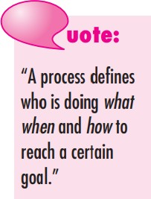
What is Software Process?
A process is a collection of activities, actions, and tasks that are performed when some work product is to be created.
Activity: Achieves a broad objective, applied universally.
Example: Communication with stakeholders.
Action: A set of tasks producing a major work product.
Example: Architectural design.
Task: A small, focused effort with a tangible result.
Example: Conducting a unit test.
Activity
Action
Task
16

Slide 68
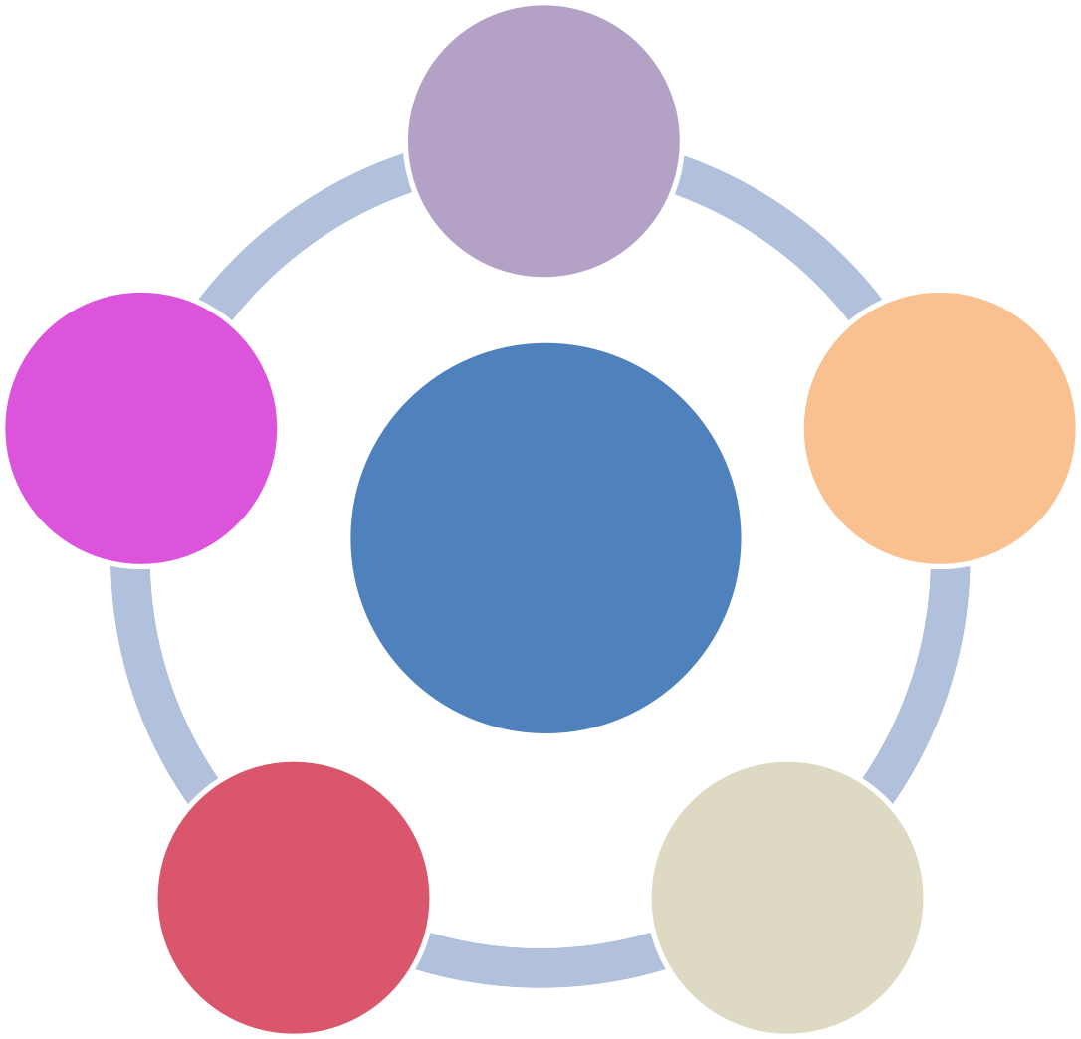
Software Process
A process framework establishes the foundation for a complete software engineering process by identifying a small number of framework activities that are applicable to all software projects, regardless of their size or complexity. In addition, the process framework encompasses a set of umbrella activities that are applicable across the entire software process The generic process framework for software engineering consists of five key activities that guide the development of software in an organized and systematic way.
Communication
Deployment
Planning
1. Communication
This involves understanding the problem and gathering requirements by communicating with stakeholders.
Goal: To clearly define what the software should do.
Example: A developer meets a client to understand the needs of an e-commerce website, such as features for user registration, product search, and payment processing.
Process
Framework
Construction
Modelling
2. Planning
This step involves creating a roadmap for the project, including schedules, resources, and cost estimation.
Goal:To outline how the project will be executed and managed.
Example: The team decides on a timeline of 3 months for developing the e-commerce website, allocates roles (developers, testers), and estimates the cost.

Slide 69
Software Process
3. Modelling
This step focuses on designing the software by creating models such as flowcharts, diagrams, or prototypes.
Goal: To represent how the software will work and look before development.
Example: The team creates a flowchart showing the user journey from browsing products to checkout and designs wireframes for the website’s user interface.
Communication
Deployment
Planning
Process
Framework
4. Construction
This involves coding and testing the software to ensure it meets the requirements.
Goal: To build the functional software.
Example: Developers write code for the shopping cart functionality, and testers verify that it calculates totals correctly, even when a discount is applied.
Construction
Modelling

Slide 70
Software Process
5. Deployment
This step delivers the software to users and ensures it is operational in the real environment.
Goal: To make the software available for use and gather feedback.
Example: The e-commerce website is launched, and users begin shopping. Based on feedback, updates are made to improve the user experience.
Communication
Deployment
Planning
Process
Framework
NOTE: simple example to understand:
Think of building a house:
Communication: Discuss the design with the homeowner.
Planning: Create a construction timeline and allocate workers.
Modelling: Draw blueprints for the house.
Construction: Build the house and test its features (e.g., plumbing, electricity).
Deployment: Hand over the keys and let the family move in.
Construction
Modelling

Slide 71

Software Process
A Process Framework : umbrella activities
An umbrella activity in a process framework refers to a set of supporting activities that occur throughout the software development lifecycle.
Software project tracking and control
Work product preparation and production
Risk Management
Software project tracking and control
Risk management
Software quality assurance
Technical reviews
Measurement
Software configuration management
Reusability management
Work product preparation and production
Reusability management
Software quality assurance
Software configuration management
Technical reviews
Measurement

Slide 72
Software Process
Measurement:
  Collects and analyzes data to evaluate project progress and quality.
  Example: Measuring lines of code (LOC) completed per week.
Software Configuration Management (SCM):
  Manages changes to software components systematically.
  Example: Using version control tools like Git for tracking code changes.
Reusability Management:
  Promotes reuse of software components to save time and effort.
  Example: Reusing a login module for multiple projects.
Work Product Preparation and Production:
  Creates documents, reports, and deliverables for stakeholders.
  Example: Preparing the final project report for client delivery
A Process Framework : umbrella activities
Umbrella Activities in a Process Framework:
Software Project Tracking and Control:
  Monitors progress to ensure the project stays on schedule.
  Example: Regular team meetings to check project milestones.
Risk Management:
  Identifies, analyzes, and mitigates potential project risks.
  Example: Preparing a backup plan for delays due to resource unavailability.
Software Quality Assurance (SQA):
  Ensures the software meets quality standards.
  Example: Conducting testing to find and fix bugs.
Technical Reviews:
  Reviews work products to identify errors early.
  Example: Code reviews by team members to ensure best practices.
Notes:
umbrella activities refer to a set of supporting processes or practices that are applied throughout the entire software development lifecycle, regardless of the specific phase or methodology being used.

Slide 73
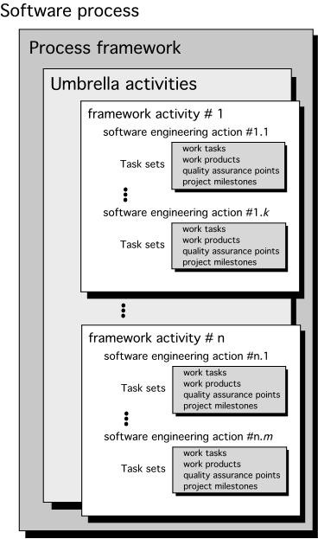
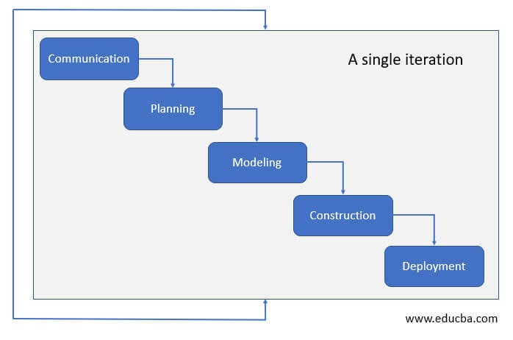
A Generic Process Model
A process was defined as a collection of activities, actions, and tasks that are performed when some work product is to be created. Each of these activities, actions, and tasks resides within a framework or model that defines their relationship with the process and with one another.
Each framework activity is populated by a set of software engineering actions. Each software engineering action is defined by a task set that identifies the work tasks that are to be completed, the work products that will be produced, the quality assurance points that will be required, and the milestones that will be used to indicate progress.
Notes:
Communication: communication between the customer and the developer.
Planning: complete estimation of the project, scheduling for development of the project, and tracking.
Modeling: This step consists of complete requirement analysis and project design like algorithm, flowchart, etc.
Construction: This step consists of code generation and its testing. Coding will implement the design details using appropriate programming languages.
Deployment: This step consists of delivering the final product to the customer and take feedback. If there are any suggestions or addition of other capabilities, then this change is required for improvement in software quality.

Slide 74
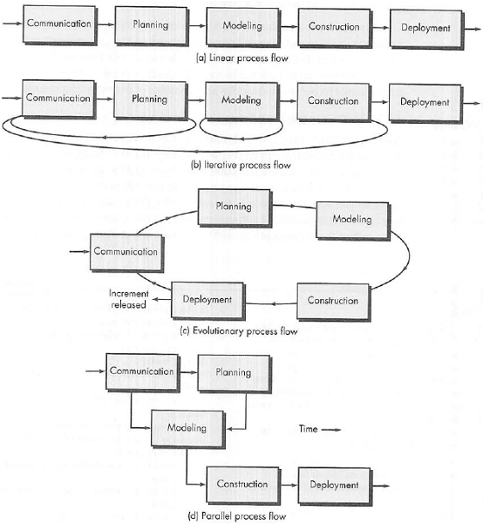
Process Flow
It executes each activity listed above in sequence form
This flow repeats one or more activities that are listed above before starting the next activity.

Slide 75
Process Flow
This flow carries out the activities listed above in a circular manner. Each circle leads to the more complete version of the software
This flow executes the activities listed above in parallel with each other

Slide 76
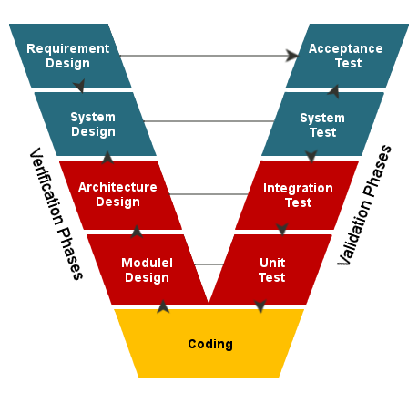
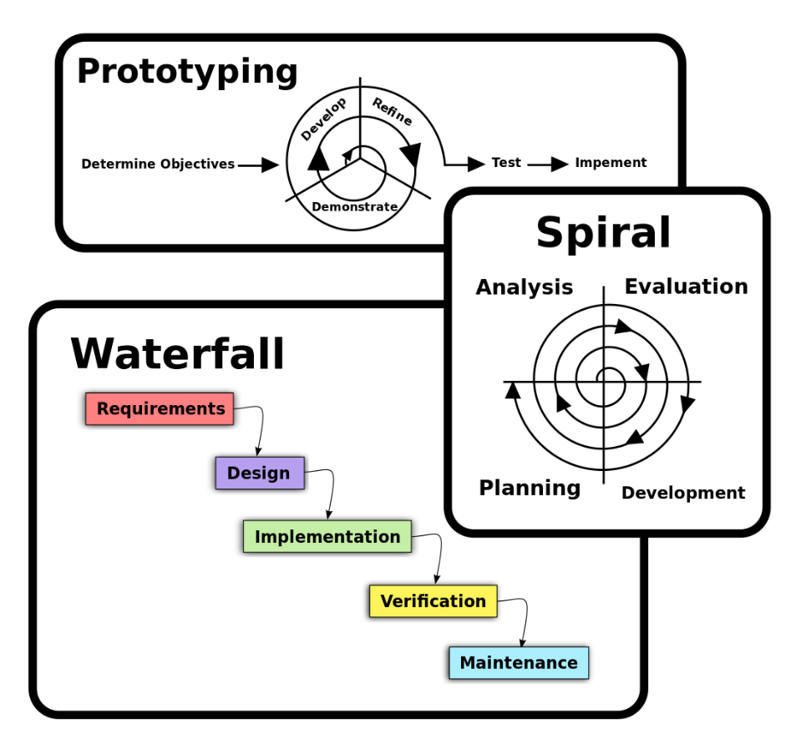
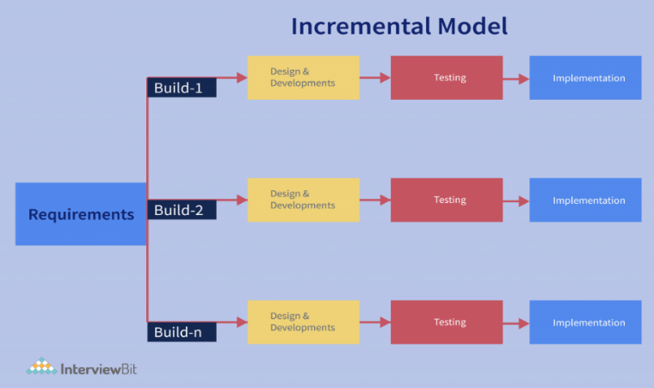
What is a software process model?
A software process model is an abstraction of the software development process.
The models specify the stages and order of a process.
So, think of this as a representation of the order of activities of the process and the sequence in which they are performed.
Popular Software Process Models:
Waterfall Model
Prototype Model
Spiral Model
V Model
Incremental Model

Slide 77
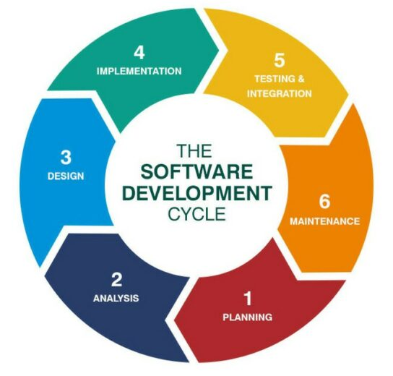
The SDLC Model
1. Planning and Requirement Analysis
Identify user needs and system requirements.
Gather input from stakeholders.
Create a detailed requirements document.
Example: A customer requests an e-commerce website with a product search feature.
2. System Design
Develop system architecture and database designs.
Decide on tools, frameworks, and platforms to use.
Create design documents like UML diagrams.
Example: Create wireframes and flowcharts for the e-commerce site.

Slide 78
The SDLC Model
3. Implementation (Coding)
Convert the design into source code.
Assign tasks to developers based on modules.
Conduct unit testing for individual components.
Example: Developers code the product search functionality.
4. Testing
Test the software for bugs and performance issues.
Perform various tests (unit, integration, system).
Validate software against requirements.
Example: Test if the search feature shows correct results.

Slide 79
The SDLC Model
5. Deployment
Install the software on production servers.
Ensure it runs smoothly for end users.
Provide initial user support.
Example: Launch the e-commerce website for customers.
6. Maintenance
Fix bugs and address user feedback.
Update the system with new features.
Monitor for any performance issues.
Example: Add a "wishlist" feature based on customer requests.

Slide 80
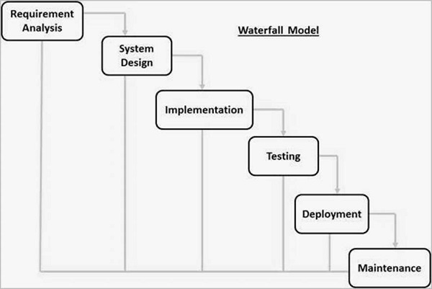
Prescriptive Models
Prescriptive Models in software development are structured frameworks that prescribe specific, sequential steps to develop software.
The Waterfall Model (linear-sequential life cycle model)
The Waterfall Model is called so because its process flows downward in a linear and sequential manner, similar to how water flows down a series of steps in a waterfall.
What Name Waterfall?
Sequential Flow
Irreversibility
Step-by-Step Progression

Slide 81
The Waterfall Model (linear-sequential life cycle model)
1. Requirement Analysis
Gather all system requirements.
Document what the system should do.
Get approval from stakeholders.
2. System Design
Plan the system’s architecture and components.
Define hardware and software requirements.
Create detailed design specifications.
3. Implementation (Coding)
Translate the design into code.
Developers work on individual modules.
Complete and test each module.
4. Integration and Testing
Combine all modules into a unified system.
Test for functionality, performance, and bugs.
Ensure the system meets the requirements.
5. Deployment
Deliver the finished product to users.
Install the system in a production environment.
Provide initial support and training if needed.
6. Maintenance
Fix issues that arise after deployment.
Update and improve the system over time.
Ensure the software remains functional and relevant.

Slide 82
The Waterfall Model (linear-sequential life cycle model)
Advantages of the Waterfall Model
Simple and Easy to Use: The step-by-step process is easy to understand and implement.
Well-Documented: Each phase has clear documentation, which helps in understanding and tracking progress.
Structured Approach: The rigid sequence ensures that no phase is skipped, reducing ambiguity.
Disadvantages of the Waterfall Model
Inflexibility: Changes are hard to incorporate once a phase is completed.
High Risk: Errors in earlier stages may not be discovered until later, increasing costs to fix them.
Unsuitable for Complex Projects: It lacks adaptability for projects with evolving requirements.

Slide 83

V & V Model
The V-Model (Verification and Validation Model) in software engineering is a software development methodology that emphasizes validation and verification processes at every stage.
It's called the V-Model because its diagram resembles the shape of the letter "V."
Each stage of development (on the left side of the "V") corresponds to a testing phase (on the right side of the "V").

Slide 84
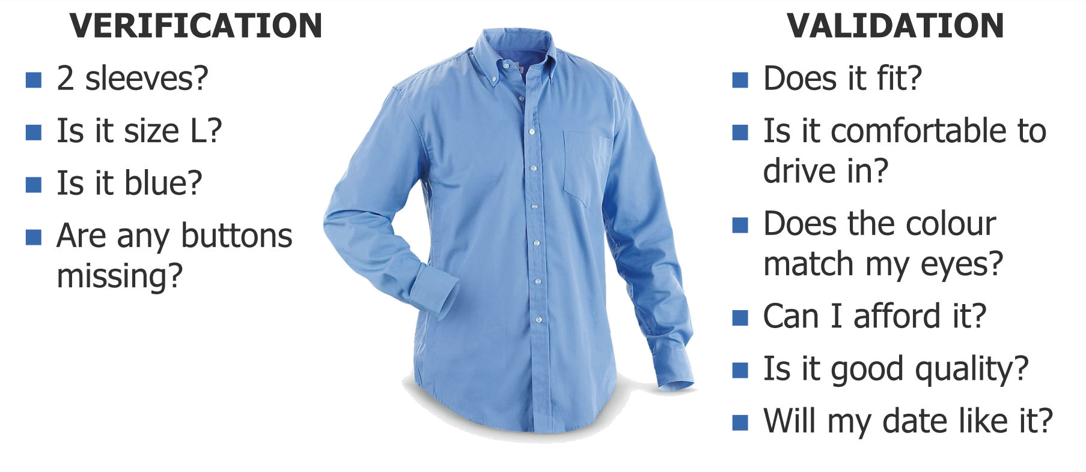
V & V Model

Slide 85
Requirement Analysis
Understand and gather the user's requirements.
Acceptance Testing (validates if the software meets user needs).
System Design
Plan the architecture and high-level system design.
System Testing (tests the entire system for functionality and performance).
Detailed Design
Focus on detailed design of modules or components.
Integration Testing (ensures modules work together).
Implementation (Coding)
Write the actual code for modules.
  Unit Testing (checks individual pieces of code).

Slide 86
V & V Model Example:
Library Management System:
Requirement Analysis
  User wants features like borrowing books, returning books, and checking availability.
  Acceptance Testing: Test if the final system meets all these features.
System Design
  Decide on modules like User Management, Book Management, and Borrowing System.
  System Testing: Test if the system works as a whole (e.g., a user borrows a book, and the inventory updates correctly).
Detailed Design
  Break down modules into components like login for User Management or inventory for Book Management.
  Integration Testing: Test interactions between components (e.g., a user logs in and can borrow books).
Implementation
  Write code for each component (e.g., a function to check book availability).
  Unit Testing: Test individual functions (e.g., does the "check availability" function work correctly?).

Slide 87
V & V Model
Advantages of the V-Model:
Clear structure and stages.
Testing is planned alongside development.
Errors can be detected early in the process.
Disadvantages:
Rigid and less flexible.
Changes in requirements can be costly.

Slide 88
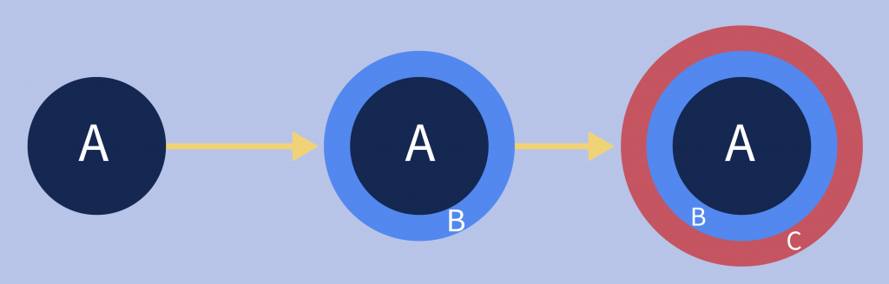
The Incremental Model
Key Steps in the Incremental Model:
Requirements Gathering: Gather the overall requirements for the system.
Divide into Increments: Split the system into smaller parts or features.
Development of Each Increment:
  Design, code, test, and deliver one increment at a time.
Integration: Combine each increment with the previous ones to build the complete system.
Repeat until all increments are delivered.

Slide 90
The cost of accommodating changing customer requirements is reduced.
  The amount of analysis and documentation that has to be redone is much less than is required with the waterfall model.
It is easier to get customer feedback on the development work that has been done.
  Customers can comment on demonstrations of the software and see how much has been implemented.
More rapid delivery and deployment of useful software to the customer is possible.
  Customers are able to use and gain value from the software earlier than is possible with a waterfall process.

Slide 91
The process is not visible.
  Managers need regular deliverables to measure progress. If systems are developed quickly, it is not cost-effective to produce documents that reflect every version of the system.
System structure tends to degrade as new increments are added.
  Unless time and money is spent on refactoring to improve the software, regular change tends to corrupt its structure. Incorporating further software changes becomes increasingly difficult and costly.

Slide 92
The Incremental Model
Example: Online Shopping Website
Imagine building an online shopping website.
Increment 1: Build the basic functionality:
  User registration and login.
  Product browsing.
Increment 2: Add advanced features:
  Search functionality.
  Product categories.
Increment 3: Add checkout features:
  Shopping cart.
  Payment gateway integration.
Increment 4: Add extra features:
  User reviews.
  Order tracking.
Each increment builds on the previous one, delivering more functionality with every phase. Users can start using the website with basic features early while waiting for full functionality.

Slide 93
The Incremental Model
Advantages:
Early feedback from users.
Easier to manage and test smaller increments.
Reduced risk since errors can be identified early.
Disadvantages:
Needs careful planning for increments.
May require more effort in integration as the system grows.

Slide 94
Process activities

Slide 95
Process activities
Real software processes are inter-leaved sequences of technical, collaborative and managerial activities with the overall goal of specifying, designing, implementing and testing a software system.
The four basic process activities of specification, development, validation and evolution are organized differently in different development processes.
For example, in the waterfall model, they are organized in sequence, whereas in incremental development they are interleaved.

Slide 96
The requirements engineering process

Slide 97
Software specification
The process of establishing what services are required and the constraints on the system’s operation and development.
Requirements engineering process
  Requirements elicitation and analysis
    What do the system stakeholders require or expect from the system?
  Requirements specification
    Defining the requirements in detail
  Requirements validation
    Checking the validity of the requirements

Slide 98
Software design and implementation
The process of converting the system specification into an executable system.
Software design
  Design a software structure that realises the specification;
Implementation
  Translate this structure into an executable program;
The activities of design and implementation are closely related and may be inter-leaved.

Slide 99
A general model of the design process

Slide 100
Design activities
Architectural design, where you identify the overall structure of the system, the principal components (subsystems or modules), their relationships and how they are distributed.
Database design, where you design the system data structures and how these are to be represented in a database.
Interface design, where you define the interfaces between system components.
Component selection and design, where you search for reusable components. If unavailable, you design how it will operate.

Slide 101
System implementation
The software is implemented either by developing a program or programs or by configuring an application system.
Design and implementation are interleaved activities for most types of software system.
Programming is an individual activity with no standard process.
Debugging is the activity of finding program faults and correcting these faults.

Slide 102
Software validation
Verification and validation (V & V) is intended to show that a system conforms to its specification and meets the requirements of the system customer.
Involves checking and review processes and system testing.
System testing involves executing the system with test cases that are derived from the specification of the real data to be processed by the system.
Testing is the most commonly used V & V activity.

Slide 103
Stages of testing

Slide 104
Testing stages
Component testing
  Individual components are tested independently;
  Components may be functions or objects or coherent groupings of these entities.
System testing
  Testing of the system as a whole. Testing of emergent properties is particularly important.
Customer testing
  Testing with customer data to check that the system meets the customer’s needs.

Slide 105
Testing phases in a plan-driven software process (V-model)

Slide 106
Software evolution
Software is inherently flexible and can change.
As requirements change through changing business circumstances, the software that supports the business must also evolve and change.
Although there has been a demarcation between development and evolution (maintenance) this is increasingly irrelevant as fewer and fewer systems are completely new.

Slide 107
System evolution

Slide 108
Coping with change

Slide 109
Change is inevitable in all large software projects.
  Business changes lead to new and changed system requirements
  New technologies open up new possibilities for improving implementations
  Changing platforms require application changes
Change leads to rework so the costs of change include both rework (e.g. re-analysing requirements) as well as the costs of implementing new functionality
System prototyping, where a version of the system or part of the system is developed quickly to check the customer’s requirements and the feasibility of design decisions. This approach supports change anticipation.

Slide 110
Change anticipation, where the software process includes activities that can anticipate possible changes before significant rework is required.
  For example, a prototype system may be developed to show some key features of the system to customers.
Change tolerance, where the process is designed so that changes can be accommodated at relatively low cost.
  This normally involves some form of incremental development. Proposed changes may be implemented in increments that have not yet been developed. If this is impossible, then only a single increment (a small part of the system) may have be altered to incorporate the change.

Slide 111
A prototype is an initial version of a system used to demonstrate concepts and try out design options.
A prototype can be used in:
  The requirements engineering process to help with requirements elicitation and validation;
  In design processes to explore options and develop a UI design;
  In the testing process to run back-to-back tests.

Slide 112
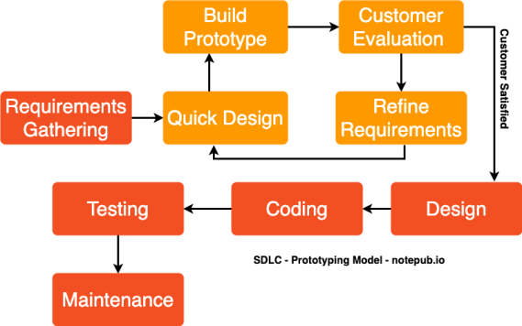
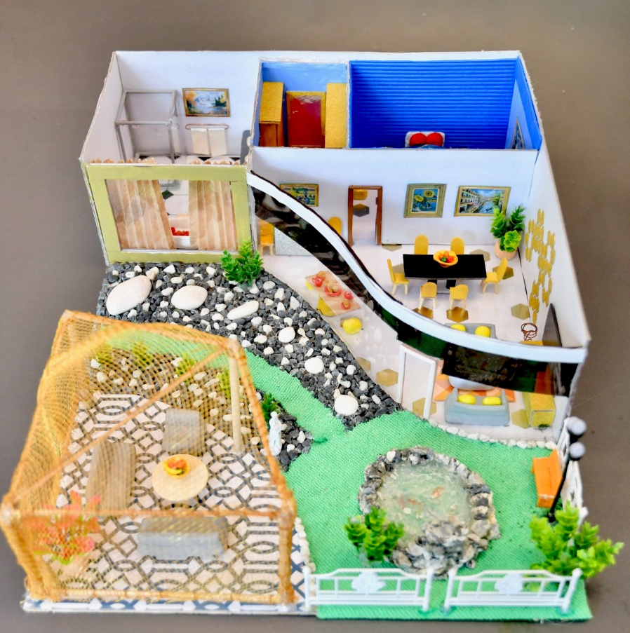
The Prototype Model (Evolutionary Models)

Slide 113
The Prototype Model (Evolutionary Models)
Requirement Gathering
  Collect the initial requirements from users.
  Identify key features needed for the prototype.
Design
  Create a basic design of the system.
  Focus on the core functionality for the prototype.
Build Prototype
  Develop a working prototype based on the design.
  The prototype includes basic features but is not fully functional.
Customer Evaluation
  Present the prototype to the customer or users.
  Get feedback on usability and features.
Review Requirements
  Analyze the feedback and see if the requirements need adjustment.
  Determine if any new features are needed.
Refine Design
  Make changes to the design based on customer feedback.
  Adjust the structure and features accordingly.
Coding
  Start coding based on the refined design.
  Implement the functionality in the system.
Testing
  Test the system for errors and bugs.
  Ensure the features work as intended.
Maintenance
  After deployment, maintain the system by fixing bugs and adding updates.
  Continue refining the system based on user needs.
This model focuses on user feedback and iteration to build a system that closely matches customer expectations.

Slide 114
Benefits of prototyping
Improved system usability.
A closer match to users’ real needs.
Improved design quality.
Improved maintainability.
Reduced development effort.

Slide 115
The Prototype Model (Evolutionary Models)
Advantages of the Prototype Model:
User Feedback
  Continuous feedback helps in better understanding of user needs and improves the system accordingly.
Reduced Risk of Failure
  Early detection of issues and requirements mismatches allows for adjustments before final development.
Better Understanding of Requirements
  Users can better visualize and clarify their requirements after seeing the prototype.
Disadvantages of the Prototype Model:
Incomplete System
  The initial prototype may lack necessary features or be too simplified, leading to a misunderstanding of the final product.
Time and Cost Overruns
  Iterative development and frequent changes can lead to longer development time and increased costs.
User Expectations
  Users might expect the prototype to be a final product, which can lead to unrealistic expectations about features and functionality.

Slide 116
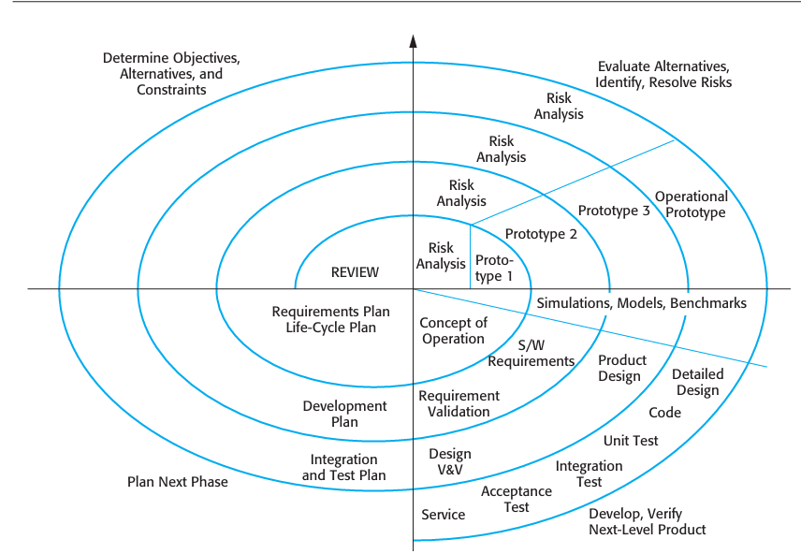
The Spiral Model

Slide 117
A risk-driven software process framework (the spiral model) was proposed by Boehm (1988).
the software process is represented as a spiral, rather than a sequence of activities with some backtracking from one activity to another.
Each loop in the spiral represents a phase of the software process. Thus, the innermost loop might be concerned with system feasibility, the next loop with requirements definition, the next loop with system design, and so on
The spiral model combines change avoidance with change tolerance.
It assumes that changes are a result of project risks and includes explicit risk management activities to reduce these risks

Slide 118
Each loop in the spiral is split into four sectors:
Objective setting Specific objectives for that phase of the project are defined. Constraints on the process and the product are identified and a detailed management plan is drawn up. Project risks are identified. Alternative strategies, depending on these risks, may be planned.
Risk assessment and reduction For each of the identified project risks, a detailed analysis is carried out. Steps are taken to reduce the risk. For example, if there is a risk that the requirements are inappropriate, a prototype system may be developed.
Development and validation After risk evaluation, a development model for the system is chosen. For example, throwaway prototyping may be the best devel opment approach if user interface risks are dominant. If safety risks are the main consideration, development based on formal transformations may be the most appropriate process, and so on. If the main identified risk is sub-system integra tion, the waterfall model may be the best development model to use.
Planning The project is reviewed and a decision made whether to continue with a further loop of the spiral. If it is decided to continue, plans are drawn up for the next phase of the project.

Slide 119
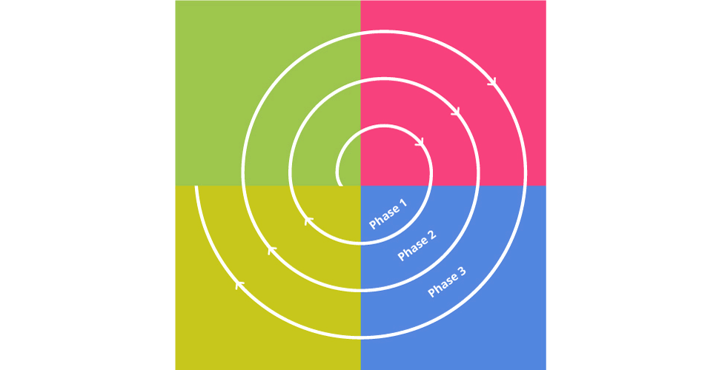
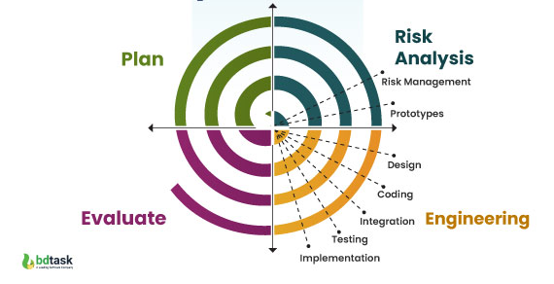
The Spiral Model
The Spiral Model is a software development process model designed to combine the benefits of iterative development and the systematic aspects of traditional waterfall models.
It is particularly suited for large, complex, and high-risk projects.
The spiral model combines the idea of iterative development with the systematic, controlled aspects of the waterfall model.
It allows incremental releases of the product or incremental refinement through each iteration around the spiral.
Notes:
In the Spiral Model, the term "spiral" refers to the iterative, circular process of development that combines elements of both design and prototyping

Slide 120
The Spiral Model
Key Features of the Spiral Model:
Risk-Driven Approach: Focuses on identifying and managing risks at every stage.
Iterative Development: Involves repeating the process in "spirals" or cycles.
Phases: Each spiral consists of the following four phases:
  Determine Objectives: Set goals, requirements, and constraints.
  Identify and Mitigate Risks: Analyze risks and plan solutions.
  Develop and Test: Create and test a prototype or part of the product.
  Evaluate and Plan Next Iteration: Review progress and plan the next cycle.
Each spiral builds upon the previous one, progressively improving the product.

Slide 121
Example: Developing an Online Shopping Website
1st Spiral (Planning and Risk Analysis):
  Objective: Define basic requirements like user registration, product catalog, and cart functionality.
  Risk Analysis: Identify potential risks, e.g., security issues in payment processing.
  Development: Create a prototype with a basic homepage and product list.
  Evaluation: Get feedback from stakeholders and users.
2nd Spiral (Refinement):
  Objective: Add functionality like user login, product search, and cart management.
  Risk Analysis: Focus on usability risks, such as a slow-loading search feature.
  Development: Implement and test these features.
  Evaluation: Gather user feedback and assess system performance.
3rd Spiral (Expansion):
  Objective: Add payment gateway integration and order tracking.
  Risk Analysis: Address risks like payment failures or data breaches.
  Development: Build these features and run security tests.
  Evaluation: Ensure the system is robust and secure.
Final Spiral (Deployment and Maintenance):
  Objective: Deploy the website and establish a maintenance plan.
  Risk Analysis: Focus on post-deployment risks like server downtime.
  Development: Finalize and launch the product.
  Evaluation: Continuously monitor and gather feedback for future updates.

Slide 122
The Spiral Model
Advantages:
Focuses on risk management.
Allows for flexibility and changes during development.
Suitable for large and complex projects.
Disadvantages:
Can be costly and time-consuming.
Requires expertise in risk analysis.
Not ideal for small or low-risk projects.

Slide 123

Thank You

